Slide 1
Zanzibar Low-Transmission Malaria Behavior Survey (MBS):
Key Findings
Mwinyi Khamis
Co-Investigator for the MBS
Head SBCC/ITNs Unit
Zanzibar Malaria Elimination Program (ZAMEP)
Introductions and Welcome

Slide 2
Zanzibar Low-Transmission Malaria Behavior Survey (MBS):
Key Findings
Johns Hopkins University
Center for Communication Programs
Carol Underwood, PhD
Ruchita Pillai, MHS
December 16, 2021

Slide 3
MBS Study Objectives, Methods, Design

Slide 4

MBS Objectives
Inform SBC strategies and programs.
  Identify and understand the demographic, ideational (e.g., knowledge, social norms, self-efficacy, intention) and contextual factors associated with:
    The use and maintenance of mosquito nets;
    Prompt and appropriate treatment of fever;
    Larval-source management
    IRS
    Reactive case detection
    Mass drug administration
  Assess recall of, participation in, malaria-related SBC

Slide 5
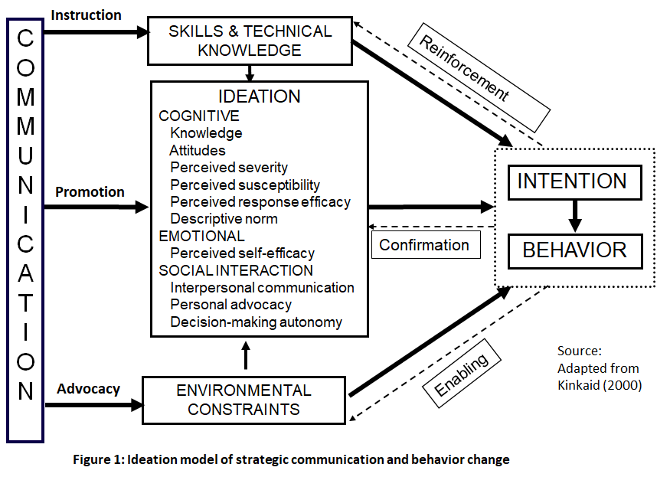
Conceptual Framework

Slide 6

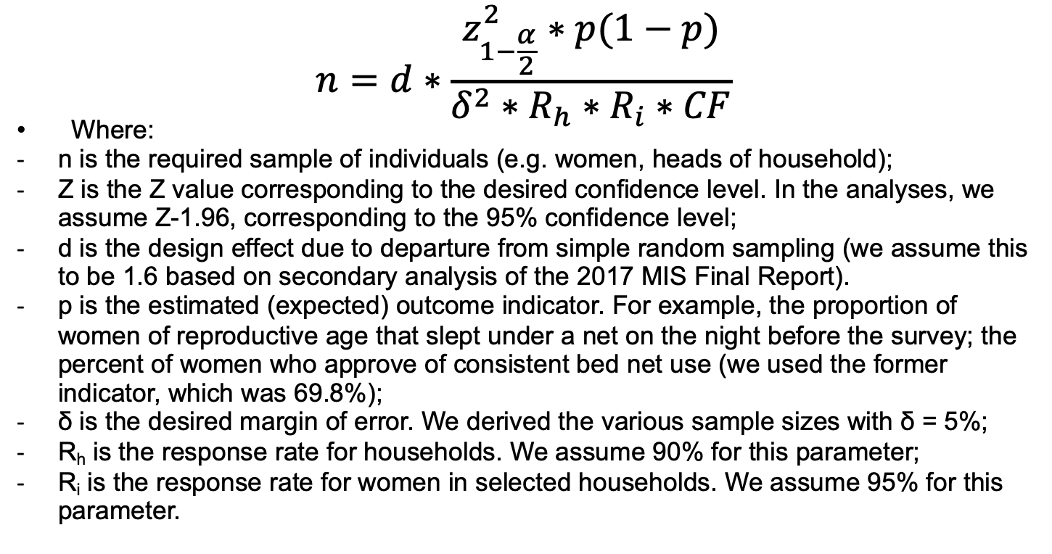
Methodology: Sample size

Slide 7
The equation used to calculate sample size yielded a sample of 740 households. Adding our oversampling from the top quadrant (25%) of the high transmission areas by 100%, the sample increased to 898 households.
Table 2: Total required sample size, by outcome and parameters (d=1.6)⁺
Sampling Indicator | Zanzibar | Oversampling high transmission areas | Final Zanzibar Sample*
Households | 740 | +158 | 898 (925)
Female Respondents** | 740 | +158 | 898 (925)
Male Respondents | 740 | +158 | 898 (925)
Total sample size |  |  | 1850**
* Final numbers include oversampling of high transmission top quadrant and in parentheses rounding up of the sample, which changes the total sample size. ** The total sample will comprise a maximum of 1850 individuals from 925 households: one woman or one man or both a man and a woman from each household + Final sample calculations based on key indicator ‘% of women of reproductive age sleeping under a bed net’: this yielded the highest required sample.

Slide 8
Methodology: Sampling strategy
Stratification by urban/rural within each zone
Selection of enumeration areas (EAs)/clusters
  Using probability proportionate to size
Selection of households
  20-21 households per cluster
Selection of Participants
  In each household, interview one eligible woman and one eligible man.

Slide 9
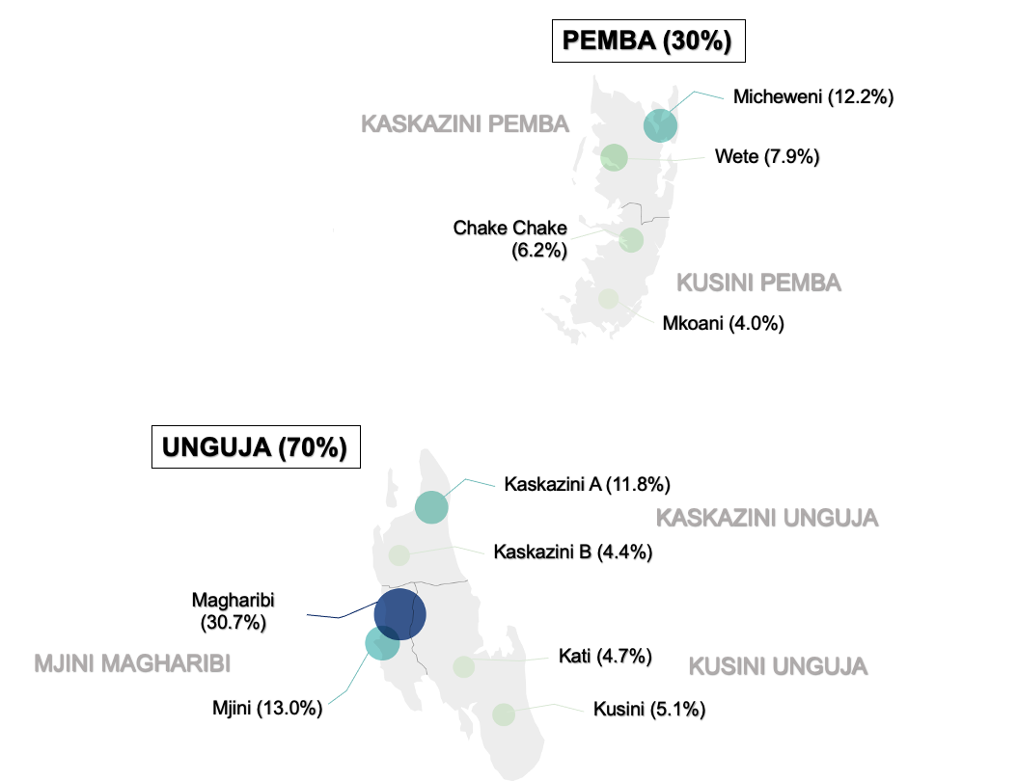


Slide 10
Respondent Characteristics

Slide 11
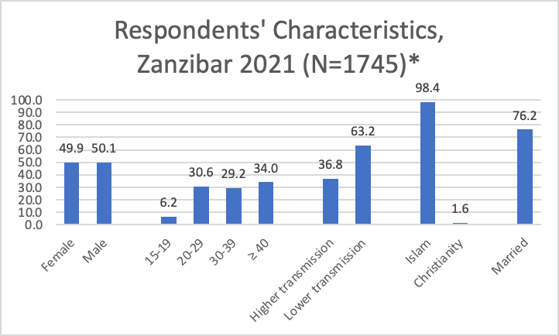
*Differences between Pemba and Unguja not significant

Slide 12
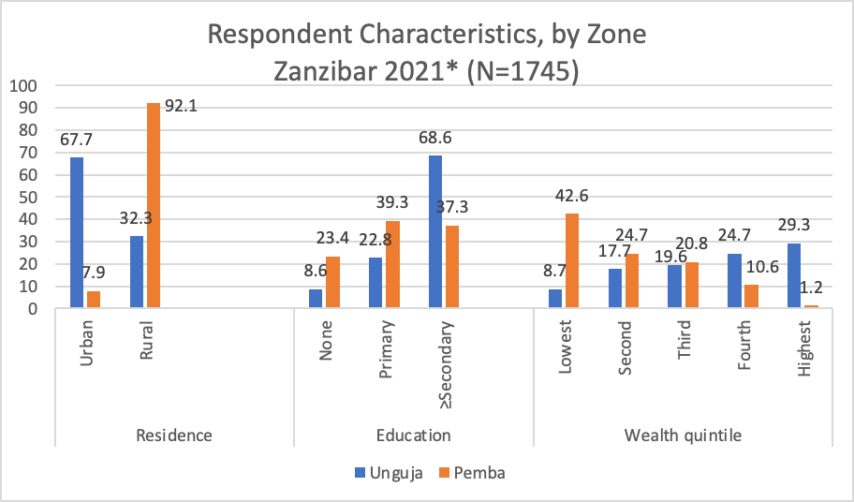
*Differences significant: p<0.05
Notes:
We wanted to highlight characteristics that differ significantly by zone. As shown here, while most respondents in Unguja are urban dwellers, most respondents in Pemba live in rural areas. This represents the distribution of the population in the two zones. Educational attainment also differed by zone; more than two-thirds of Unguja residents completed secondary school or had post-secondary education, while only a third had done so in Pemba. The wealth distribution is also notably different, with the preponderance of Pemba residents in the lowest quintile, and a plurality of Unguja residents in the highest quintile.

Slide 13
Cross-cutting Ideational Factors

Slide 14
Glossary of terms used in the MBS Perceived susceptibility is the belief that one is likely to be affected by a health problem. Perceived severity is the perception that the consequences of a condition are severe. Perceived response efficacy is the belief that a recommended action will help a person avoid the threat. Perceived self-efficacy is a belief in an individual’s ability to take relevant actions. Descriptive norms are the perceptions of what other people do, while injunctive norms are the perceptions of what is approved or disapproved of by others. Interpersonal communication is the discussion with others regarding relevant topics. Decision-making autonomy is a person’s active involvement in relevant decisions.

Slide 15
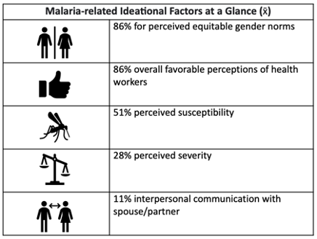
Ideational Factors: Malaria

Slide 16
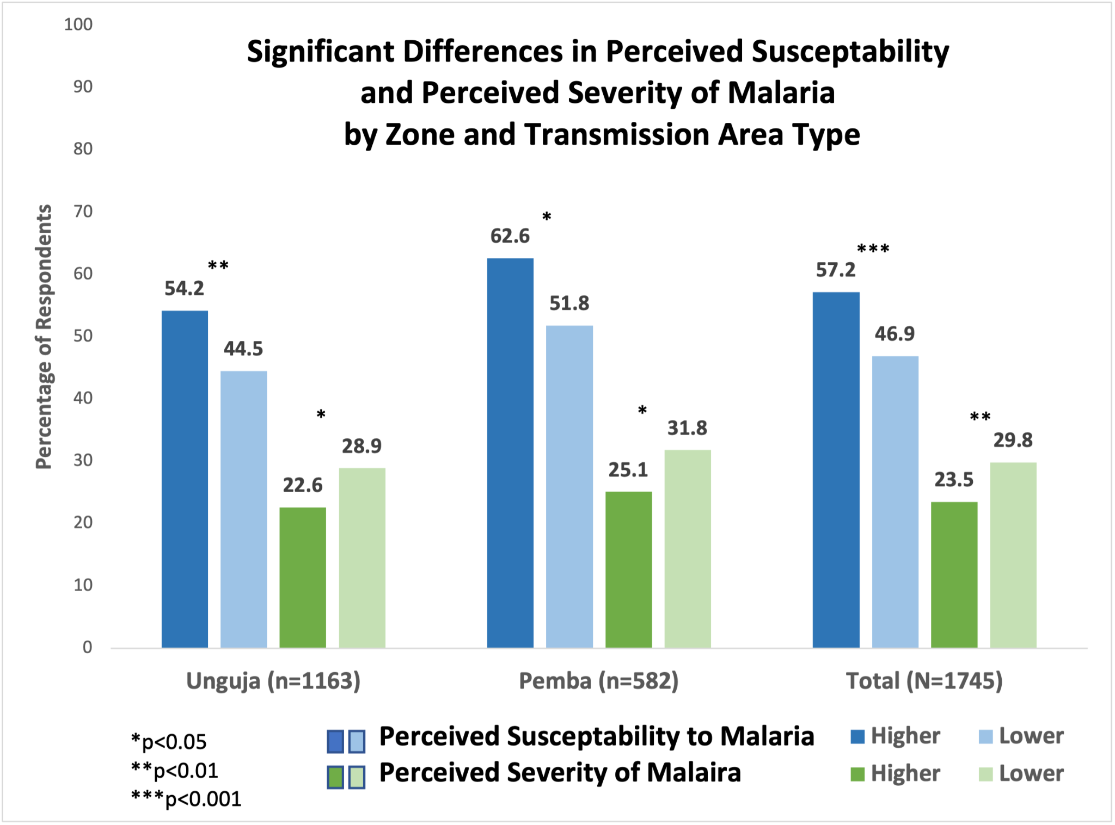
Ideational Factors

Slide 17
Attitudes towards health providers and workers
  Favorable attitudes towards facility-based health providers were significantly and positively associated with women, rural residence, higher transmission areas, and lower income quintiles
  Women, older respondents, and those living in higher transmission areas were significantly more likely to register favorable attitudes towards CHWs.

Slide 18
Malaria Case Management

Slide 19
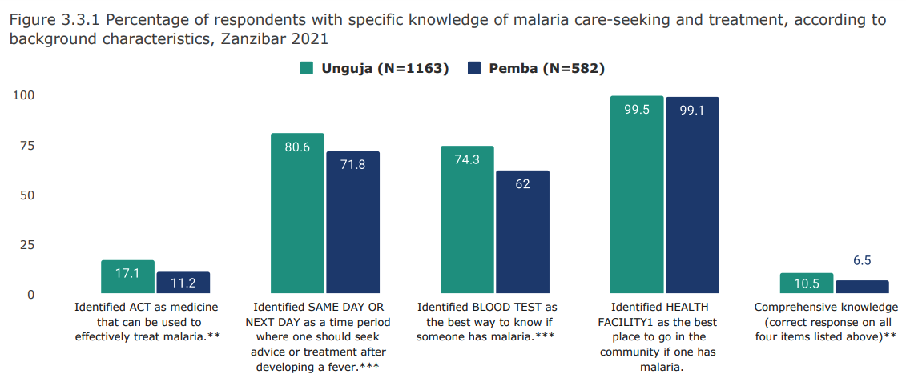
Knowledge: Care-seeking & Treatment

Slide 20
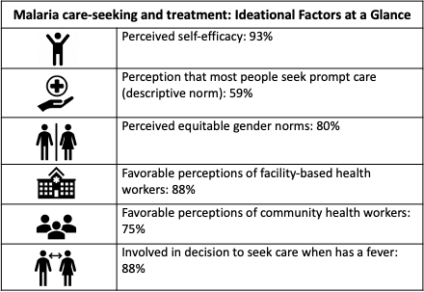
Ideational Factors: Malaria Case Management

Slide 21
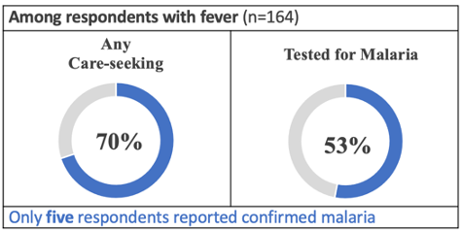

Slide 22
Mosquito Net/
Insecticide-Treated Net Use

Slide 23
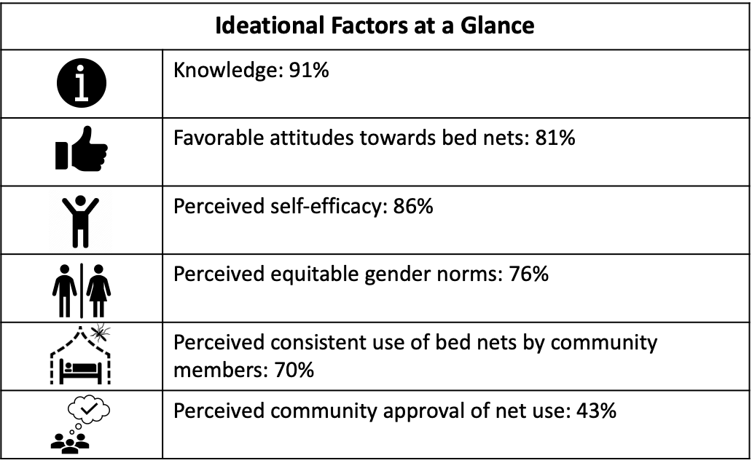
Ideational Factors Associated with Mosquito Nets

Slide 24
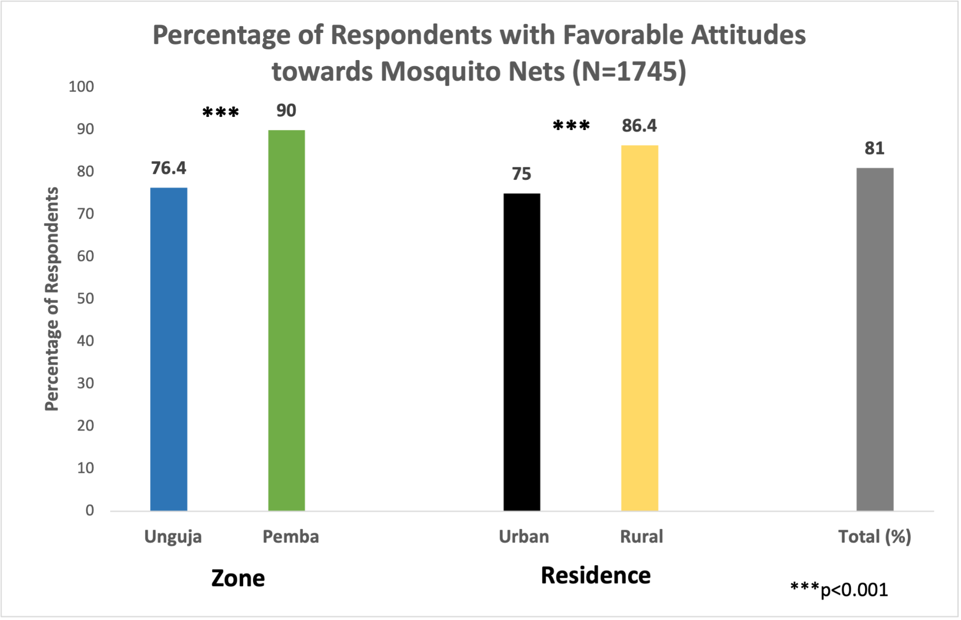
Ideational Determinants of Net Use
It is not easy to bring a net when I spend the night away from home
(65% agreed with the statement)
Treated mosquito nets attract bed bugs and other insects
(59% agreed with the statement)
Notes:
Two of the key UNfavorable attitudes towards mosquito nets

Slide 25
Key UNfavorable Attitudes towards Mosquito Nets
It is not easy to bring a net when I spend the night away from home (65% agreed with the statement)
Treated mosquito nets attract bed bugs and other insects (59% agreed with the statement)

Slide 26
Ideational Determinants of Net Use
Response efficacy: 67% of respondents agreed with the statement: My chances of getting malaria are the same whether or not I sleep under a mosquito net
But most (86%) agreed that sleeping under a mosquito net every night is the best way to avoid getting malaria.
Most respondents (86%) also had high perceived self-efficacy for net use, with sleeping outside (55%) and sleeping/working away from home (60-71%) being two instances of lower perceived self-efficacy to net use.
Community norm: at least half of the community members sleep under net every night
  more respondents from Pemba (87%) reported supportive net use community norm than from Unguja (62%)
  more Rural respondents (76%) reported supportive net use community norm than Urban respondents (64%)

Slide 27
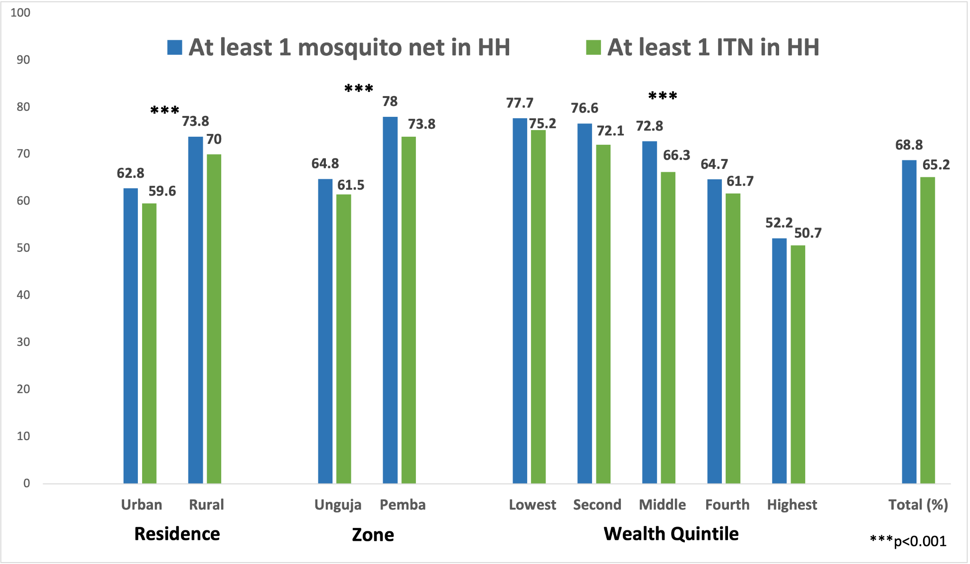
Household Net and ITN Access
Notes:
Households is the unit here (N=1007)

Slide 28
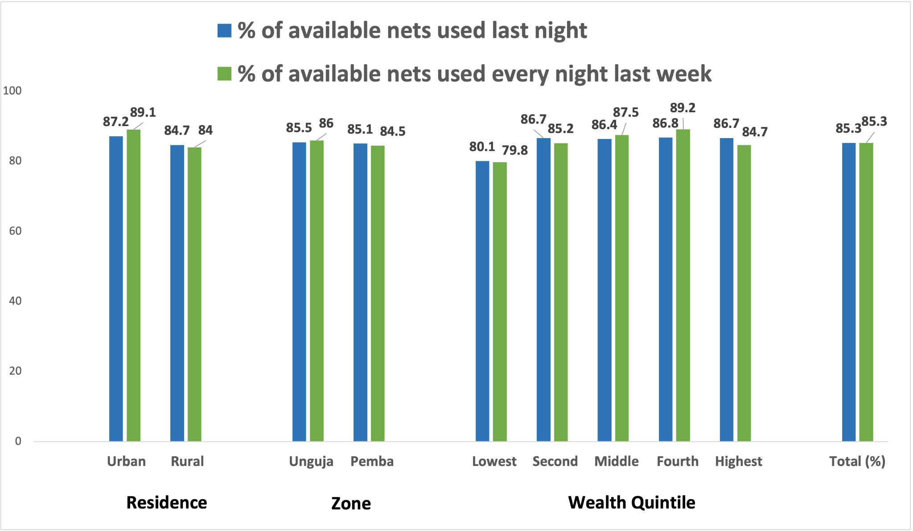
Use of Available Nets (n=1289)
Notes:
Nets within HHs is the unit here (n=1289) - No differences

Slide 29
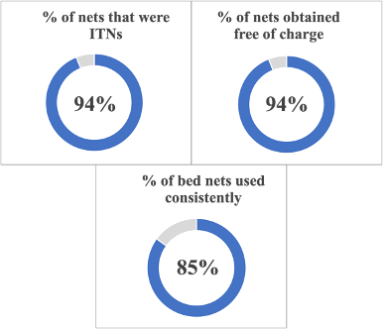

Slide 30
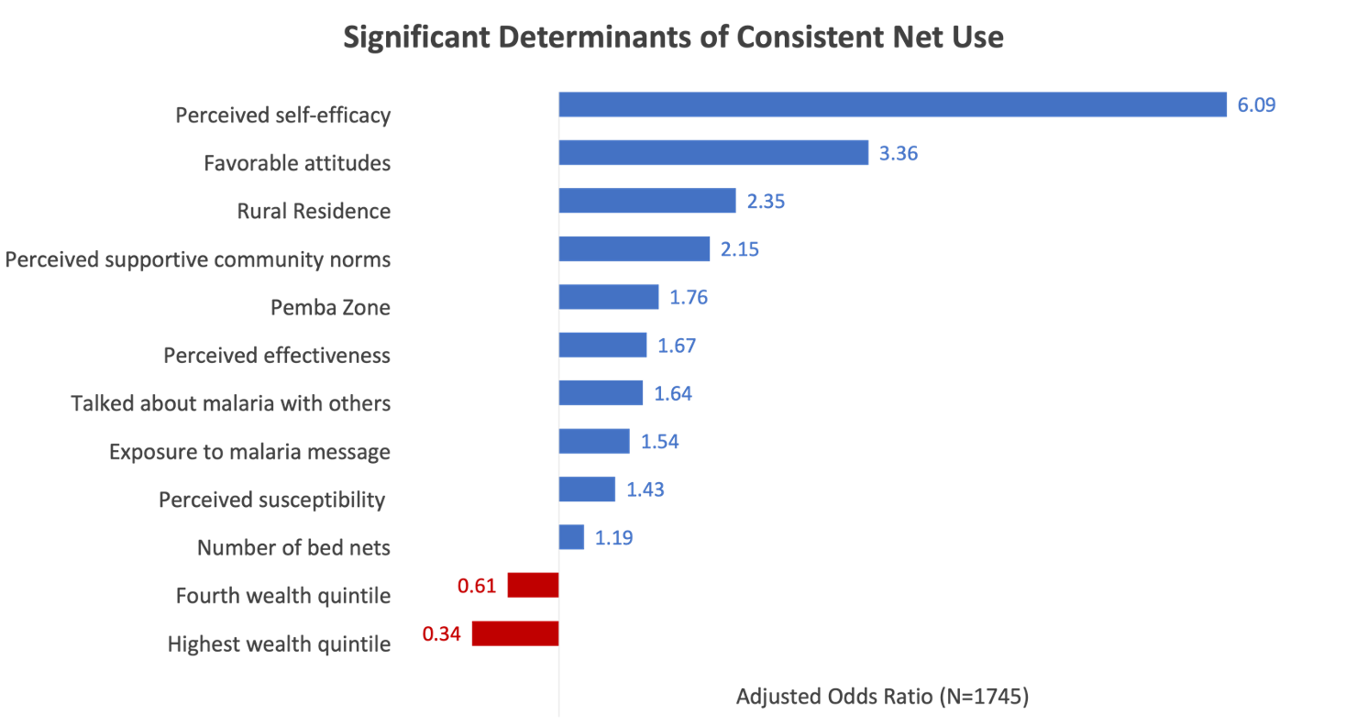
Notes:
Importantly, the several of the strongest associations with consistent net use were ideational. Significantly higher adjusted odds ratios (aOR) of consistent malaria net use were observed for the following ideational factors: perceived self-efficacy, favorable attitudes toward net use, supportive descriptive community norms, favorable attitudes, and perceived susceptibility. Communication about malaria with family or friends and recall of malaria messages were also associated with significantly higher adjusted odds ratios. Where respondents lived was also found to be associated with consistent net use: The odds ratios were higher among residents of Pemba compared with Unguja, and among rural residents compared with urban dwellers. The number of nets in the household, one measure of access, was positively associated with a significantly higher odds ratio. Interestingly, wealth quintiles were associated with a negative odds ratio.

Slide 31
Indoor Residual Spraying (IRS)

Slide 32
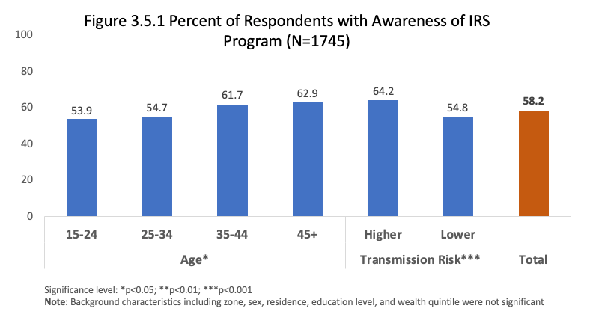
IRS Awareness

Slide 33
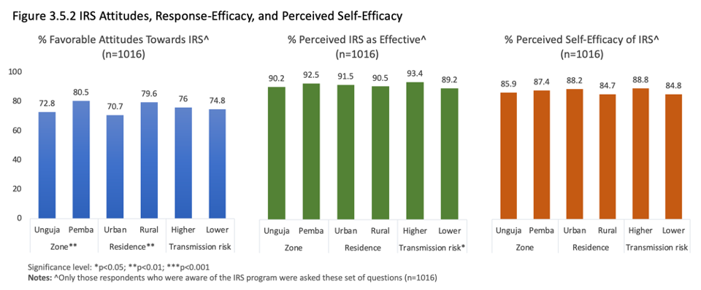

Slide 34
Ideational Determinants of IRS
Attitudes (limiting)
Many people develop skin problems (rashes, itching) after the walls inside their houses are sprayed with insecticide
  60% agreed with this statement
People have problems with bugs/bed bugs after the walls are sprayed
  48% agreed with this statement
It bothers me to leave my possessions outside of my house while my walls are being sprayed
  44% agreed with this statement
Response Efficacy (supporting)
Spraying the inside walls of a house is an effective way to prevent malaria
  94% agreed with this statement
People who live in houses that have been sprayed are less likely to get malaria
  92% agreed with this statement

Slide 35
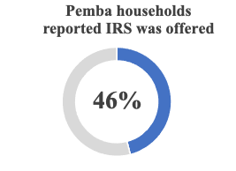
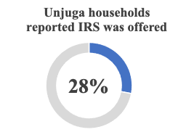
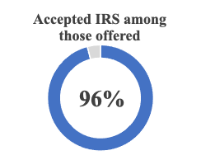
Among those aware of IRS (n=1016)

Slide 36
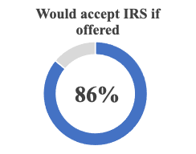
All respondents; N=1745. Only significant difference by transmission risk: higher transmission risk areas: 89%; lower transmission risk areas: 84%.

Slide 37
Larval Source Management:
Larviciding

Slide 38
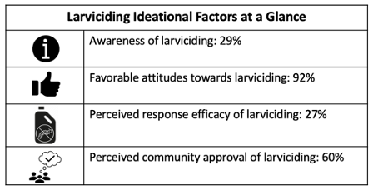

Slide 39
Ideational Determinants of Larviciding
Awareness
More respondents in Unguja (40%) reported being aware of larviciding programs than those in Pemba (7%; p<0.001)
More Urban respondents (42%) than Rural respondents (17%; p<0.001)
Favorable Attitudes
More Urban respondents (94%) with favorable attitudes than Rural respondents (90%; p<0.01)
More respondents in higher transmission areas (95%) than those in lower transmission areas (90%; p<0.001)
Perceiving Larvicing as effective
More respondents in Pemba (35%) perceived larviciding as effective than those in Unguja (22%; p<0.001)
More Rural respondents (33%) than Urban respondents (19%; p<0.001)
While most (82%) agreed with the statement: Treating water bodies with larvicide as frequently as once per week throughout the year is a good way to avoid getting malaria.
Only 27% disagreed with the statement: The chances of getting malaria are the same whether or not water bodies in the area are treated with larvicide.

Slide 40
Larviciding coverage
Only 6% of households reported that a larviciding program had come to their communities in the past 12 months.
The only difference was associated with wealth quintiles; the relationship was not linear.

Slide 41
Media Consumption &
Message Recall

Slide 42
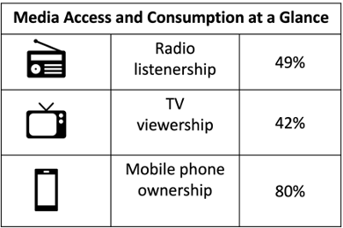
Media Access & Consumption
(from Individual Questionnaire; N=1745)
Radio/TV: Men, Unguja residents, urban dwellers, higher educational attainment, higher wealth brackets
Mobile phone: Men, older respondents, urban dwellers, higher transmission areas, at least a secondary education, upper wealth quintiles associated with significantly higher levels of ownership.
Smartphone: Ownership significantly different by zone: Unguja: 53%; Pemba 15%

Slide 43
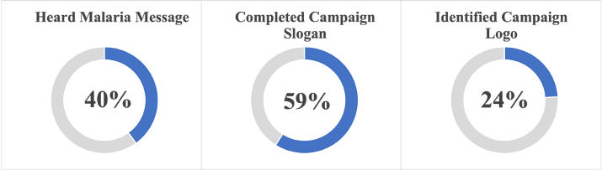
Malaria Message Recall
Zone***:
Unguja: 44% Pemba: 31%
Residence***:
Urban: 45% Rural: 35%
Zone***:
Unguja: 66% Pemba: 45%
Residence***:
Urban: 69% Rural: 51%
Zone***:
Unguja: 26% Pemba: 20%
Residence**:
Urban: 28% Rural: 21%

Slide 44
Reactive Case Detection (RCD)
Households and individuals within a specific area are tested and treated for malaria at their home/community when malaria cases in that area become detected, with the goal of preventing further malaria transmission by identifying additional infections, whether symptomatic or asymptomatic, and treating them.

Slide 45
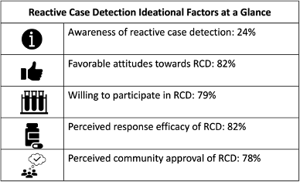

Slide 46
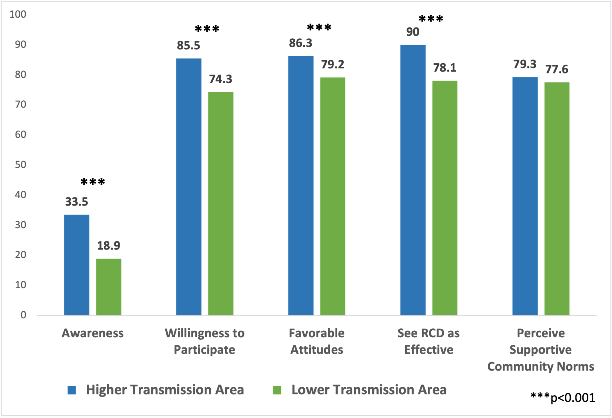
Ideational Determinants of RCD

Slide 47
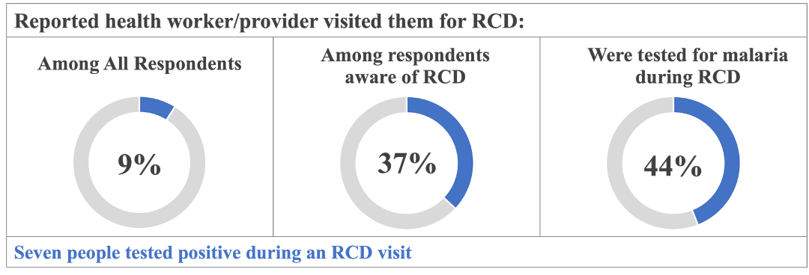
Reactive Case Detection Coverage
Zone***:
Unguja: 31% Pemba: 46%
Transmission Risk***:
Higher: 48% Lower: 24%
Notes:
9% of all respondents reported a health worker or provider visiting their household/community for RCD.
Respondents who were aware of RCD were asked if a health worker or health provider visited their house for RCD within the past 12 months. Of those respondents, 37% answered in the affirmative. Home visits for RCD were significantly more likely to be reported by respondents in Pemba (46%) compared with Unguja (31%). Home visits for RCD were also significantly more likely to be reported by respondents in higher transmission risk areas (48%) compared to lower transmission risk areas (24%).
Of those who were visited for RCD, 44% were tested for malaria; only seven people reported testing positive.

Slide 48
Mass Drug Administration (MDA)

Slide 49
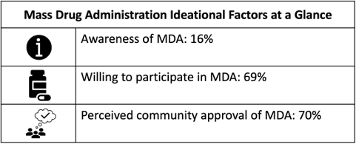
Awareness of MDA programs was slightly higher in respondents with higher levels of education, in older respondents, and among male respondents.
Urban respondents (75%) more likely to accept antimalarials from MDA than rural respondents (64%), even when not feeling sick.

Slide 50
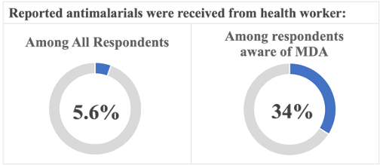
MDA Coverage
Statistically significant difference by zone: Unguja: 42%; Pemba: 21%
Notes:
Among those who were aware of MDA, 34% (or 5.6% of all respondents) reported that a health worker or provider had visited their workplace to distribute antimalarials to them or their coworkers in the past year. The only statistically significant difference by background characteristics was found by zone (Unguja: 42%; Pemba: 21%).

Slide 51
Questions, Comments, Suggestions

